Slide 1
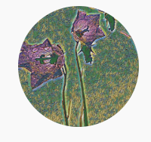
Problems on Counting 2002

Slide 2
Reference
Data
Youtube
Code

Slide 3
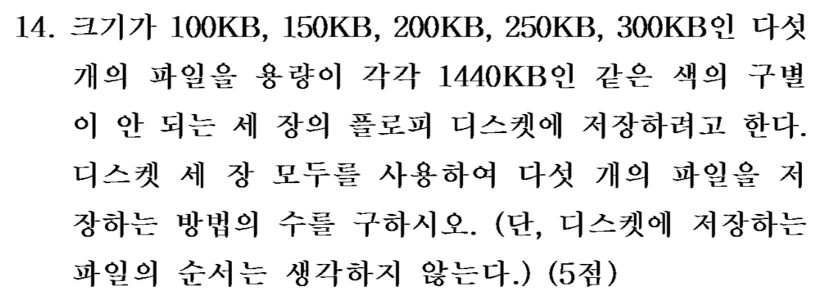
[2002]

Slide 4
First,
we assume
all three disks are distinct,
call them a, b, c.

Slide 5
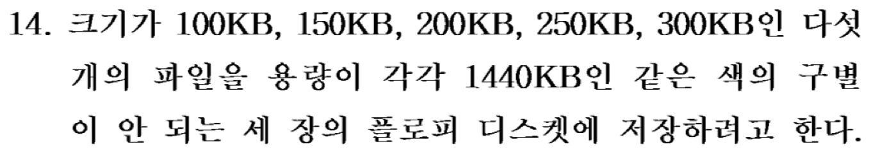

Slide 6
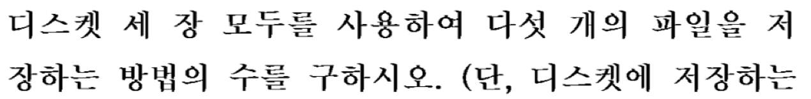

Slide 7


Slide 8
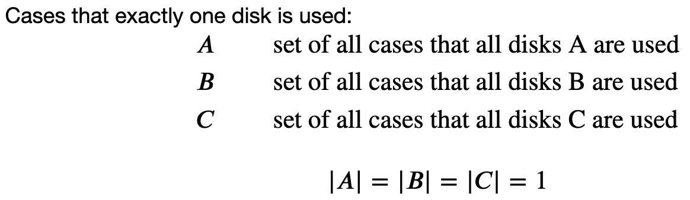


Slide 13
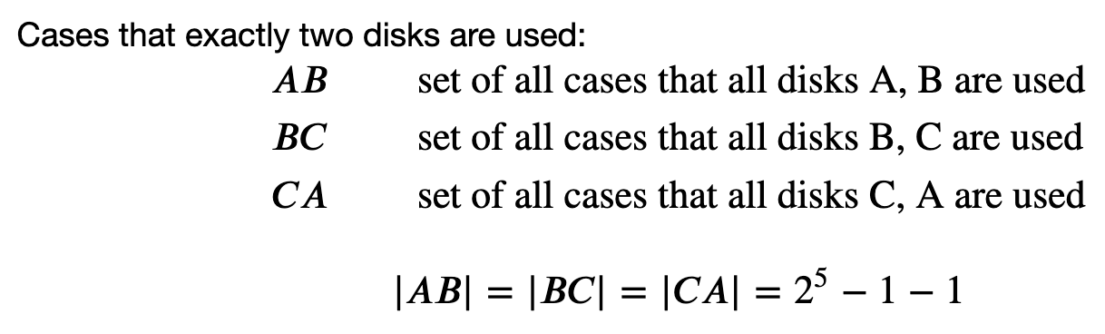

Slide 18
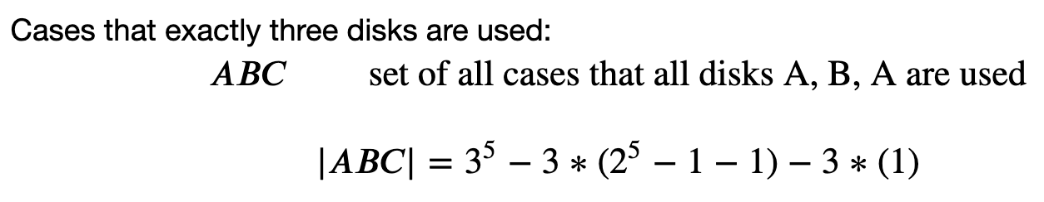

Slide 21
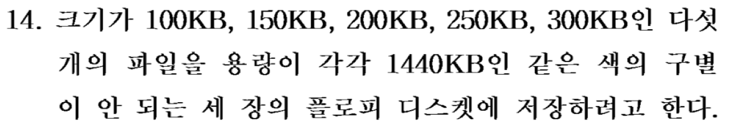

Slide 22
Now,
we assume
all three disks are indistinguishable.

Slide 23
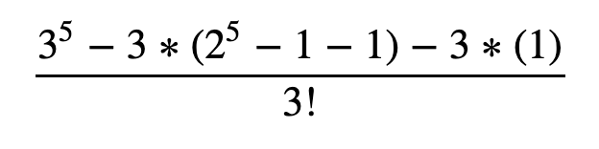

Slide 24
